Slide 1




Real-world Health Application
2025
Lung Cancer Prediction
Using Machine Learning
Presented by
Page 1
Aviral Yadav
DS Undergraduate IIT MADRAS
Next Slide

Slide 2

2025
Problem Statement
"Ho kya raha hai?"
Lung cancer is deadly. Early detection = higher survival chances.
We're building a model that can predict the likelihood of lung cancer using symptoms, lifestyle factors, and medical history—before it’s too late.
Goal: Build a classifier that flags high-risk patients using 15+ health-related inputs.
Page 2
Next Slide
~ Aviral Yadav

Slide 3
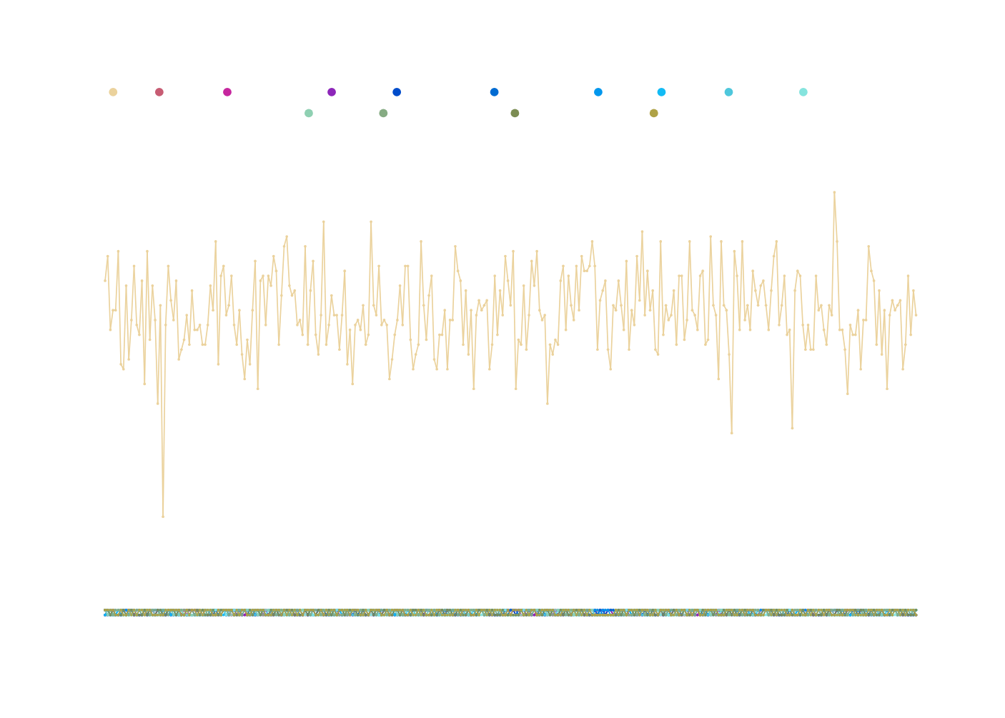
2025
Dataset
Overview
Dataset Specs:
Total Rows: 309
Columns: 16
Type: Health classification dataset
Each row = an individual
Each column = a health/lifestyle factor
Page 3
Next Slide
~ Aviral Yadav

Slide 4
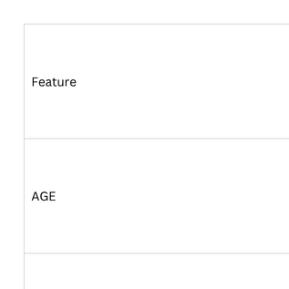
2025
Features Used
Preprocessing
Converted categorical (YES/NO) to numeric (2 = Yes, 1 = No)
Checked for missing/null values
Label encoded target variable
Normalization done if needed (for certain models)
Page 4
Next Slide
~ Aviral Yadav

Slide 5
2025
We trained and tested the following
Each model was evaluated using
Logistic Regression
K-Nearest Neighbors (KNN)
Decision Tree
Random Forest
Naive Bayes
Support Vector Machine (SVM)
Accuracy
Confusion Matrix
Precision / Recall
F1 Score
Model
Building
Page 5
Next Slide
~ Aviral Yadav

Slide 6
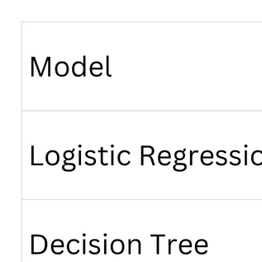
2025
Performance
Comparison
Random Forest chosen for best accuracy and generalization
Page 6
Next Slide
~ Aviral Yadav

Slide 7

2025
Challenges
Faced
🔍 Class imbalance tackled via oversampling/threshold tuning
❌ Non-linearity handled with tree-based models
❓ Interpreting health features like “yellow fingers” or “peer pressure” in medical context
🧹 Cleaned noisy/ambiguous data entries
Page 7
Next Slide
~ Aviral Yadav

Slide 8

2025
Final Outcome
✅ Successfully built a binary classifier for lung cancer risk
🎯 Achieved ~90% accuracy with Random Forest
🩺 Real-world application for health screening & awareness
Learnings
End-to-end classification pipeline
Real-world healthcare data handling
Importance of EDA and feature understanding
How small preprocessing steps can make/break ML models
& What I Learned
Page 8
Next Slide
~ Aviral Yadav

Slide 9

2025
Future
Scope
🧪 More data → better generalization
🧠 Try deep learning for higher accuracy
🌐 Build a web interface using Streamlit for demo
📱 Integrate with basic health screening apps
Page 9
Next Slide
~ Aviral Yadav

Slide 10
2025
Thank
You!
Contact:
aviralyadav501@gmail.com
Page 10
Next Slide
~ Aviral Yadav

